Slide 1













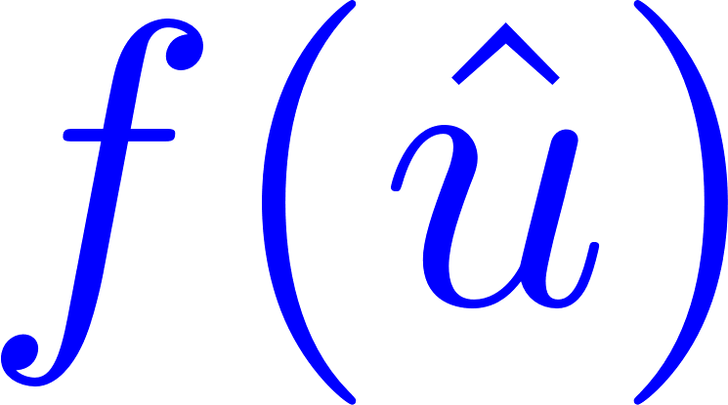
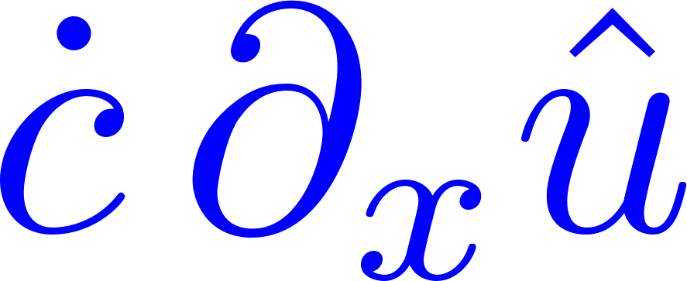
Data
collection
Template fitting
with template
Black-boxed FOM
FOM data
Aligned FOM data
Reconstruction equation
POD of centered data
Spatial modes
Shifting speed data
Construct ROM dynamics
From FOM to ROM
polynomial functions to be learned
Minimizing the objective function
Learning
error in
error in

